Slide 1
A Simple Shortest Path Algorithm with Linear Average Time
Andrew V. Goldberg
F. Meyer auf der Heide (Ed.): ESA 2001, LNCS 2161, pp. 230~241, 2001.
()Springer-Verlag Berlin Heidelberg 2001
Presenter: Chiao-Wei Chiu (邱喬偉)
Date: Feb. 8, 2007

Slide 2
Abstract
We present a simple shortest path algorithm. If the input lengths are positive and uniformly distributed, the algorithm runs in linear time. The worst-case running time of the algorithm is O (m + n log C), where n and m are the number of vertices and arcs of the input graph, respectively, and C is the ratio of the largest and the smallest nonzero arc length.

Slide 3
Problem Definition
Input: a directed graph G = (V, A) with n vertices, m arcs, a source vertex s, and nonnegative arc lengths l(a).
Goal: find shortest paths from the source to all vertices of the graph.

Slide 4
Special Case
We assume that arc lengths are integers in the interval [1,…, U], where U denotes the biggest arc length. Let δ be the smallest nonzero arc length and let C be the ratio of the biggest arc length to δ.

Slide 5
Labeling Method
d(v): distance
p(v): parent
S(v): status = { unreached, labeled, scanned}.
Initially d(v) = ∞, p(v) = nil, and S(v) = unreached.
starts by setting d(s) = 0 and S(s) = labeled.
While there are labeled vertices, the method picks such a vertex v, scans all arcs out of v, and sets S(v) = scanned. To scan an arc (v,w), one checks if d(w) > d(v)+l(v,w) and, if true, sets d(w) = d(v)+l(v,w), p(w) = v, and S(w) = labeled.

Slide 6
Lemma 1
c(v): the minimum length of an arc entering v
μ: lower bound on distance labels of labeled vertices.
If μ + c(v) ≧ d(v), then d(v) is exact.

Slide 7
Algorithm Description
computes c(v) for every vertex v.
Our algorithm keeps labeled vertices in one of two places: a set F (double-link list) and a priority queue B (multi-level bucket).
Vertices in F have exact distance labels and if F is nonempty, we remove and scan a vertex from F.
If F is empty, we remove and scan a vertex from B with the minimum distance label.
Suppose a distance label of a vertex u decreases. If u belongs to B, then we relocates u within B or discovers that u's distance label is exact and moves u to F. If u was neither in B nor F, we apply the insert operation to u, and u is inserted either into B or, if d(u) is determined to be exact, into F.

Slide 8
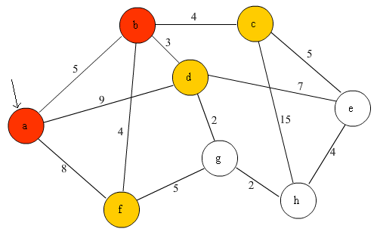
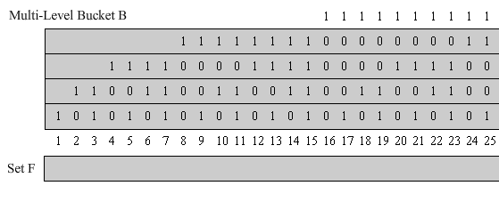
Example

Slide 9
Lemma 2
Lemma 2. At any point of the execution, all labeled vertices are in the range of at most three consecutive top level buckets.

Slide 10
Correctness
Algorithm correctness follows from Lemmas 1 and 2, and the observations that μ is always set to a minimum distance label of a labeled vertex, μ remains a lower bound on the labeled vertex labels, and F always contains vertices with exact distance labels.

Slide 11
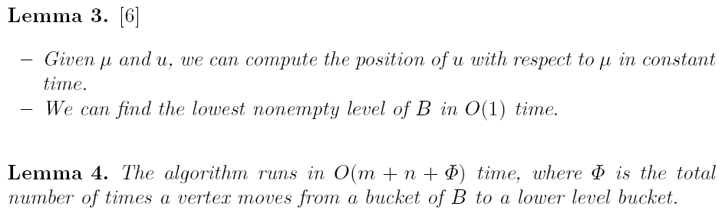
Worst-Case Analysis
The worst-case running time of the algorithm is O (m + n log C).

